Slide 1
3-6 PERFORMANCE
One important issue in networking is the performance of the network—how good is it? We discuss quality of service, an overall measurement of network performance, in greater detail in Chapter 24. In this section, we introduce terms that we need for future chapters.
Topics discussed in this section:
Bandwidth - capacity of the system
Throughput - no. of bits that can be pushed through
Latency (Delay) - delay incurred by a bit from start to finish
Bandwidth-Delay Product
3.‹#›
Notes:
‹#›

Slide 2

Note
In networking, we use the term bandwidth in two contexts.
The first, bandwidth in hertz, refers to the range of frequencies in a composite signal or the range of frequencies that a channel can pass.
The second, bandwidth in bits per second, refers to the speed of bit transmission in a channel or link. Often referred to as Capacity.
3.‹#›
Notes:
‹#›

Slide 3
Throughput
The throughput is a measure of how fast we can actually send data through a network.
Difference between bandwidth and throughput :
A link may have a bandwidth of B bps, but we can only send T bps through this link with T always less than B.
The bandwidth is a potential measurement of a link, the throughput is an actual measurement of how fast we can send data.
3.‹#›
Notes:
‹#›

Slide 4
Example: we may have a link with bandwidth of 1 Mbps, but the devices connected to the end of the link may handle only 200 kbps. This means that we cannot send more than 200 kpbs through this link.
3.‹#›
Notes:
‹#›

Slide 5

Example 3.44
A network with bandwidth of 10 Mbps can pass only an average of 12,000 frames per minute with each frame carrying an average of 10,000 bits. What is the throughput of this network?
Solution
We can calculate the throughput as
The throughput is almost one-fifth of the bandwidth in this case.
3.‹#›
Notes:
‹#›

Slide 6
3.‹#›

Slide 7
Propagation & Transmission delay
Propagation speed - speed at which a bit travels through the medium from source to destination.
Transmission speed - the speed at which all the bits in a message arrive at the destination. (difference in arrival time of first and last bit)
3.‹#›

Slide 8
Propagation and Transmission Delay
Propagation Delay = Distance/Propagation speed
Transmission Delay = Message size/bandwidth bps
Latency = Propagation delay + Transmission delay + Queueing time + Processing time
3.‹#›

Slide 9

Example 3.45
What is the propagation time if the distance between the two points is 12,000 km? Assume the propagation speed to be 2.4 × 108 m/s in cable.
Solution
We can calculate the propagation time as
The example shows that a bit can go over the Atlantic Ocean in only 50 ms if there is a direct cable between the source and the destination.
3.‹#›
Notes:
‹#›

Slide 10
_{The Latency or} delay defines how long it takes for an entire message to completely arrive at the destination from the time the first bit is sent out from the source
3.‹#›

Slide 11
Example 3.46
What are the propagation time and the transmission time for a 2.5-kbyte message (an e-mail) if the bandwidth of the network is 1 Gbps? Assume that the distance between the sender and the receiver is 12,000 km and that light travels at 2.4 × 108 m/s.
Solution
We can calculate the propagation and transmission time as shown on the next slide:
3.‹#›
Notes:
‹#›

Slide 12
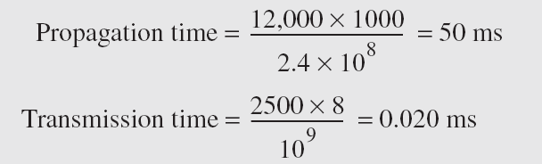
Example 3.46 (continued)
Note that in this case, because the message is short and the bandwidth is high, the dominant factor is the propagation time, not the transmission time. The transmission time can be ignored.
3.‹#›
Notes:
‹#›

Slide 13
Example 3.47
What are the propagation time and the transmission time for a 5-Mbyte message (an image) if the bandwidth of the network is 1 Mbps? Assume that the distance between the sender and the receiver is 12,000 km and that light travels at 2.4 × 10⁸ m/s.
Solution
We can calculate the propagation and transmission times as shown on the next slide.
3.‹#›
Notes:
‹#›

Slide 14
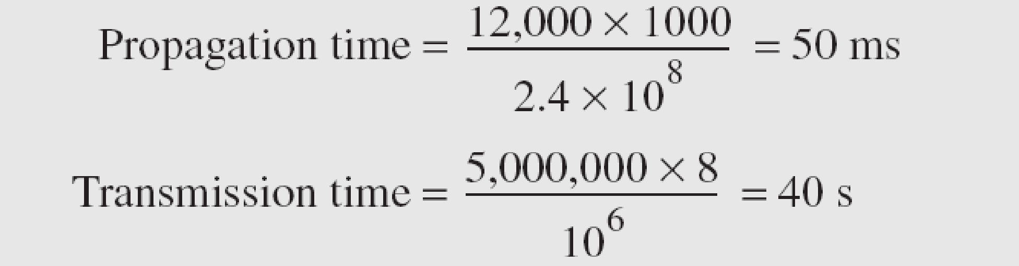
Example 3.47 (continued)
Note that in this case, because the message is very long and the bandwidth is not very high, the dominant factor is the transmission time, not the propagation time. The propagation time can be ignored.
3.‹#›
Notes:
‹#›

Slide 15
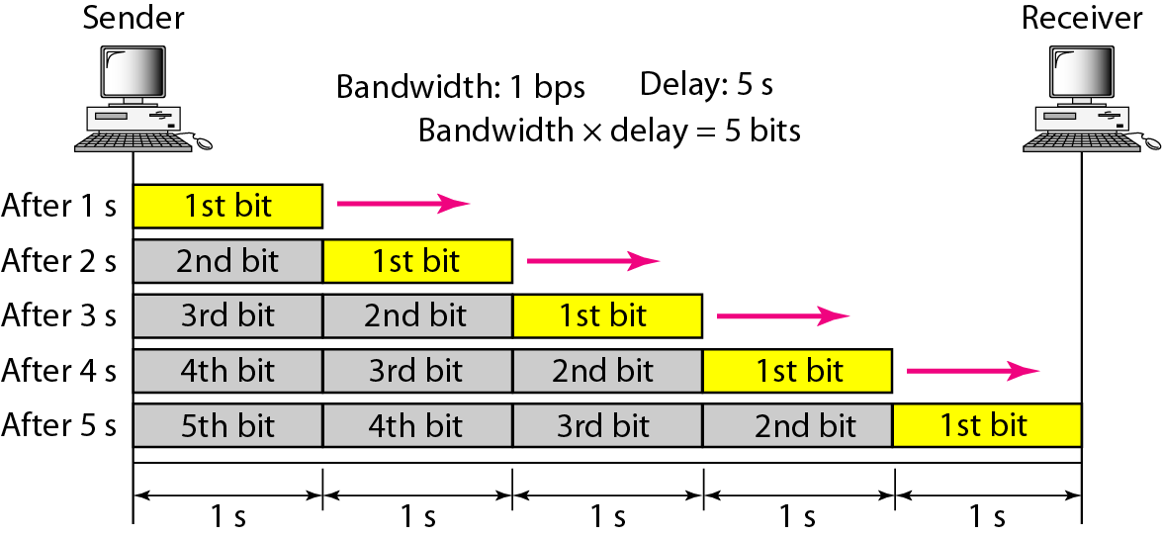
Figure 3.31 Filling the link with bits for case 1
3.‹#›
Notes:
‹#›

Slide 16
Example 3.48
We can think about the link between two points as a pipe. The cross section of the pipe represents the bandwidth, and the length of the pipe represents the delay. We can say the volume of the pipe defines the bandwidth-delay product, as shown in Figure 3.33.
3.‹#›
Notes:
‹#›

Slide 17
Notes:
‹#›

Slide 18
Note
The bandwidth-delay product defines the number of bits that can fill the link.
3.‹#›
Notes:
‹#›

Slide 19

Figure 3.33 Concept of bandwidth-delay product
3.‹#›
Notes:
‹#›

